Slide 1
Reprezentare grafica a algoritmului roy-floyd
Andrei Niculae

Slide 2
Demo time

Slide 3
Roy – Floyd
int i, j, k;
for (k = 0; k < nodes.size(); k++)
for (i = 0; i < nodes.size(); i++)
for (j = 0; j < nodes.size(); j++)
if (a[i][k] && a[k][j] && (a[i][j] > a[i][k] + a[k][j] || !a[i][j]) && i != j)
a[i][j] = a[i][k] + a[k][j];

Slide 4


Slide 5
Simple Fast Multimedia Library

Slide 6
The code

Slide 7
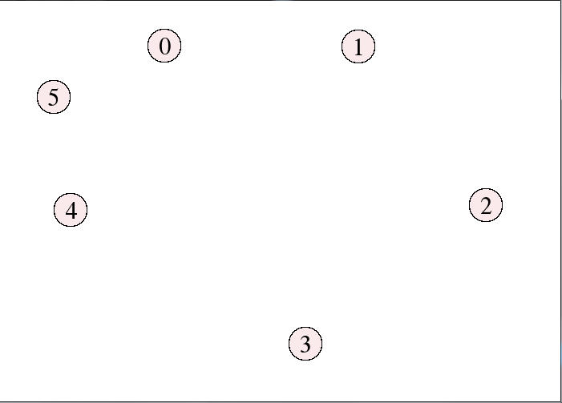
Day 1
std::vector<sf::CircleShape> nodes;
std::vector<sf::Text> indexes; //indecsi
while (window.isOpen())
{
sf::Event event;
while (window.pollEvent(event))
{
if(sf::Event::MouseButtonPressed)
if (event.mouseButton.button == sf::Mouse::Left)
{
draw_node_store_in_vector();
draw_index_store_in_vector();
}
}
window.clear(sf::Color::White);
draw_graph();
window.display();
}

Slide 8
void draw_node_store_in_vector()
{
sf::CircleShape circle(20.0f); //raza de 20
float radius = circle.getRadius();
circle.setPointCount(100); //explicatii?
circle.setFillColor(sf::Color(251, 234, 235)); //culoarea
circle.setOutlineThickness(1.5f); //marginea
circle.setOutlineColor(sf::Color(0, 0, 0));
circle.setPosition(sf::Vector2f(sf::Mouse::getPosition(window))); //pozitia cercului = pozitia mousului
circle.setOrigin(radius, radius);
nodes.push_back(circle); //il bag in vectorul nodes
}
void draw_index_store_in_vector()
{
sf::Text index;
index.setFont(font);
index.setString(std::to_string(indexes.size()));
index.setCharacterSize(30);
index.setFillColor(sf::Color::Black);
index.setOrigin(7.f, 19.f);
index.setPosition(sf::Vector2f(sf::Mouse::getPosition(window)));
indexes.push_back(index);
}

Slide 9
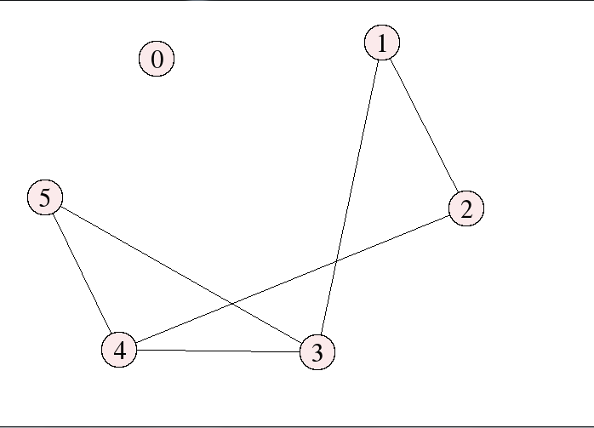
Day 2
if (event.key.code == sf::Keyboard::M)
for (int i = 0; i < nodes.size(); i++)
{
pos.push_back(nodes[i].getPosition());
}
for (int i = 0; i < pos.size(); i++)
{
for (int j = 0; j < pos.size(); j++)
{
if (a[i][j])
{
draw_edge_store_in_vector(i, j, sf::Color::Black, edges);
}
}

Slide 10
void draw_edge_store_in_vector(int i, int j, sf::Color color, std::vector<sf::VertexArray> &vector)
{
sf::VertexArray line(sf::Lines, 2);
line[0].position = pos[i];
line[0].color = color;
line[1].position = pos[j];
line[1].color = color;
vector.push_back(line);
}

Slide 11
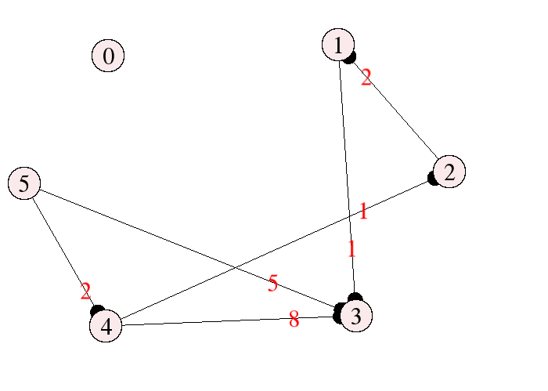
Day 3-4
if (event.key.code == sf::Keyboard::M)
for (int i = 0; i < nodes.size(); i++)
{
pos.push_back(nodes[i].getPosition());
}
for (int i = 0; i < pos.size(); i++)
{
for (int j = 0; j < pos.size(); j++)
{
if (a[i][j])
{
draw_edge_store_in_vector(i, j, sf::Color::Black, edges);
draw_costs_store_in_vector(i, j, a, sf::Color::Red);
draw_direction_store_in_vector(i, j, sf::Color::Black, directions);
}
}

Slide 12
void draw_costs_store_in_vector(int i, int j, int mat[101][101], sf::Color color)
{
sf::Text cost;
cost.setFont(font);
cost.setString(std::to_string(mat[i][j]));
cost.setCharacterSize(30);
cost.setFillColor(color);
cost.setOrigin(7.f, 19.f);
cost.setPosition(pos[i].x + (3 * (pos[j].x - pos[i].x) / 4), pos[i].y + (3 * (pos[j].y - pos[i].y) / 4));
costs.push_back(cost);
}
void draw_direction_store_in_vector(int i, int j, sf::Color color, std::vector<sf::CircleShape> &vector)
{
sf::CircleShape circle(10.0f);
float radius = circle.getRadius();
circle.setPointCount(100);
circle.setFillColor(color);
float slope2 = atan2(pos[j].y - pos[i].y, pos[j].x - pos[i].x); //TRIGONOMETRY, IS THAT YOU?
int offset = 20;
circle.setPosition(pos[j].x - offset * cos(slope2), pos[j].y - offset * sin(slope2)); //YES IT IS
circle.setOrigin(radius, radius);
vector.push_back(circle);
}

Slide 13
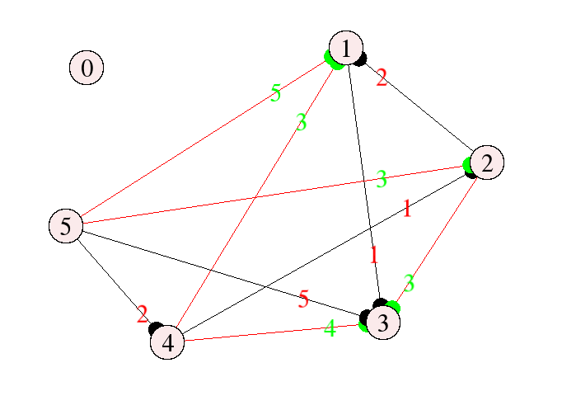
Day 5
for (int i = 0; i <= nodes.size(); i++)
for (int j = 0; j <= nodes.size(); j++)
{
if (a[i][j])
{
if (a[i][j] != b[i][j])
{
draw_costs_store_in_vector(i, j, a, sf::Color::Green);
draw_edge_store_in_vector(i, j, sf::Color::Red, edges);
draw_direction_store_in_vector(i, j, sf::Color::Green, directions);
}
else
{
draw_costs_store_in_vector(i, j, a, sf::Color::Red);
draw_edge_store_in_vector(i, j, sf::Color::Black, edges);
draw_direction_store_in_vector(i, j, sf::Color::Black, directions);
}

Slide 14
But where is the good stuff? GIVE US THE GOOD STUFF

Slide 15
Day 6-7

Slide 16
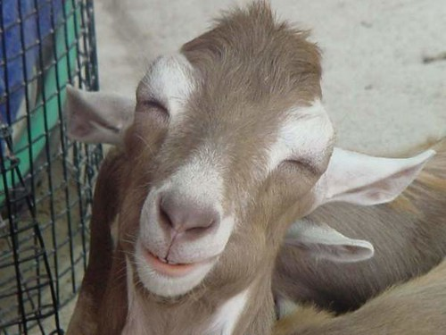
YAY, moore code
//Roy-Floyd
int i, j, k;
for (i = 0; i < nodes.size(); i++)
{
for (j = 0; j < nodes.size(); j++)
{
for (k = 0; k < nodes.size(); k++)
{
window.clear(sf::Color::White);

Slide 17
//set temporary values for the current frame
draw_edge_store_in_vector(i, k, sf::Color::Green, temp_edges);
draw_edge_store_in_vector(k, j, sf::Color::Green, temp_edges);
draw_edge_store_in_vector(i, j, sf::Color::Red, temp_edges);
if (i != j && i != k && k != j)
{
draw_direction_store_in_vector(i, k, sf::Color::Green, temp_directions);
draw_direction_store_in_vector(k, j, sf::Color::Green, temp_directions);
draw_direction_store_in_vector(i, j, sf::Color::Red, temp_directions);
}
nodes[i].setOutlineColor(sf::Color::Red);
nodes[j].setOutlineColor(sf::Color::Red);
nodes[k].setOutlineColor(sf::Color::Green);
nodes[i].setOutlineThickness(5.0f);
nodes[j].setOutlineThickness(5.0f);
nodes[k].setOutlineThickness(5.0f);

Slide 18
draw_graph(); //functie care deseneaza toate elementele din vectorii cu forme, indecsi, muchii, costuri
sf::sleep(waitTime); //Practic cea mai importanta functie din tot programul
window.display();
if (a[i][k] && a[k][j] && (a[i][j] > a[i][k] + a[k][j] || !a[i][j]) && i != j)
{
a[i][j] = a[i][k] + a[k][j];
sf::sleep(solutionWaitTime); //Timp de asteptare pentru a vedea solutia
}

Slide 19

Mersi ca m-ati ascultat
si stiu ca va doare capul de la atata cod
Asa ca...
uite o poza cu un arici

